Slide 1
PROJECT TITLE
IBM HACKATHON PROJECT
Presented By: Milan Jena & Ashish Kumar Sahoo
Faculty name : Deepneel Majumdar
Student Name_1 : Milan Jena
Student Name_2 : Ashish Kumar Sahoo
College Name & Department : Veer Surendra Sai University Of Technology

Slide 2
OUTLINE
Problem Statement
Technology used
Wow factor
End users
Result
Conclusion
Git-hub Link
Future scope
IBM Certifications

Slide 3
Problem Statement
Improvements in patient outcomes can only come from early and precise detection of breast cancer, although there are limitations with the procedures used today. There is a need for more dependable, non-invasive, and easily accessible diagnostic methods, and using artificial intelligence to predict breast cancer offers a promising way to improve diagnostic efficiency and accuracy. For early detection and individualised treatment plans to advance, reliable AI models must be developed.

Slide 4
Technology used
IBM CLOUD
Python
Juypter Notebook

Slide 5
IBM cloud services used
AI / Machine Learning
Watsonx.ai Studio-ul
Watson.ai Runtime-fm
Storage
Cloud Object Storage-lw

Slide 6
Wow factors
This project focuses on improving breast cancer detection and treatment by leveraging artificial intelligence (AI). What makes it unique is its emphasis on:
Early and precise detection – Addressing the limitations of current diagnostic procedures.
Non-invasive and accessible methods – Aiming to develop more patient-friendly diagnostic solutions.
AI-driven prediction – Utilizing artificial intelligence to enhance accuracy and efficiency.
Individualized treatment plans – Tailoring treatment based on AI predictions for better patient outcomes.By combining AI with non-invasive diagnostics, the project seeks to make breast cancer detection more reliable and accessible while improving personalized treatment approaches.

Slide 7
End users
The end users of this project would include:
Patients – Especially those at risk of or diagnosed with breast cancer, benefiting from early detection and personalized treatment plans.
Oncologists & Radiologists – Medical professionals who will use AI-driven tools to enhance diagnostic accuracy and treatment planning.
Hospitals & Diagnostic Centers – Healthcare institutions that will integrate AI-powered solutions into their diagnostic workflows.
Medical Researchers – Scientists and AI specialists working on improving breast cancer detection and treatment methodologies.
Healthcare Policymakers – Authorities who can use the findings to improve cancer screening programs and healthcare policies.Would you like a more detailed breakdown of how each user group benefits from this project?

Slide 8
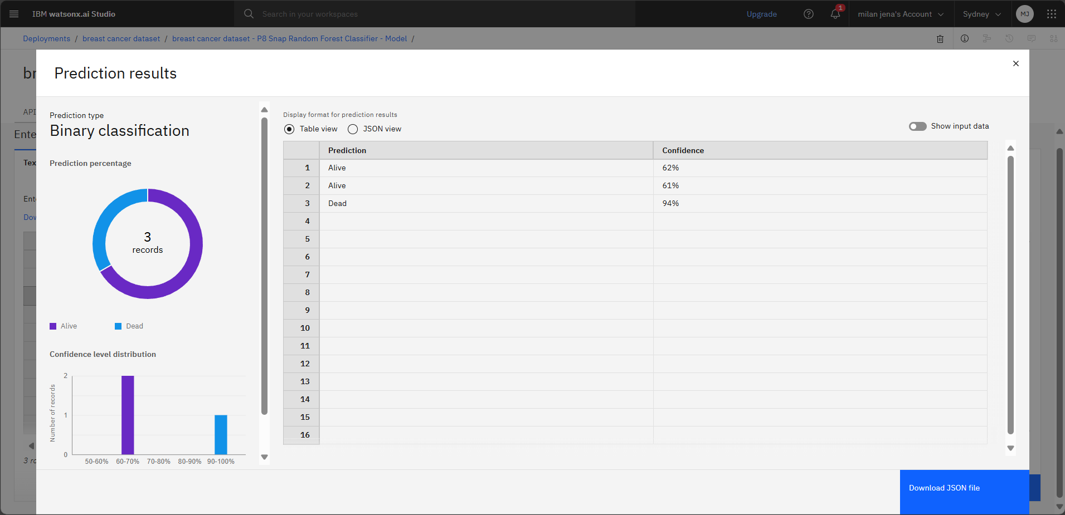
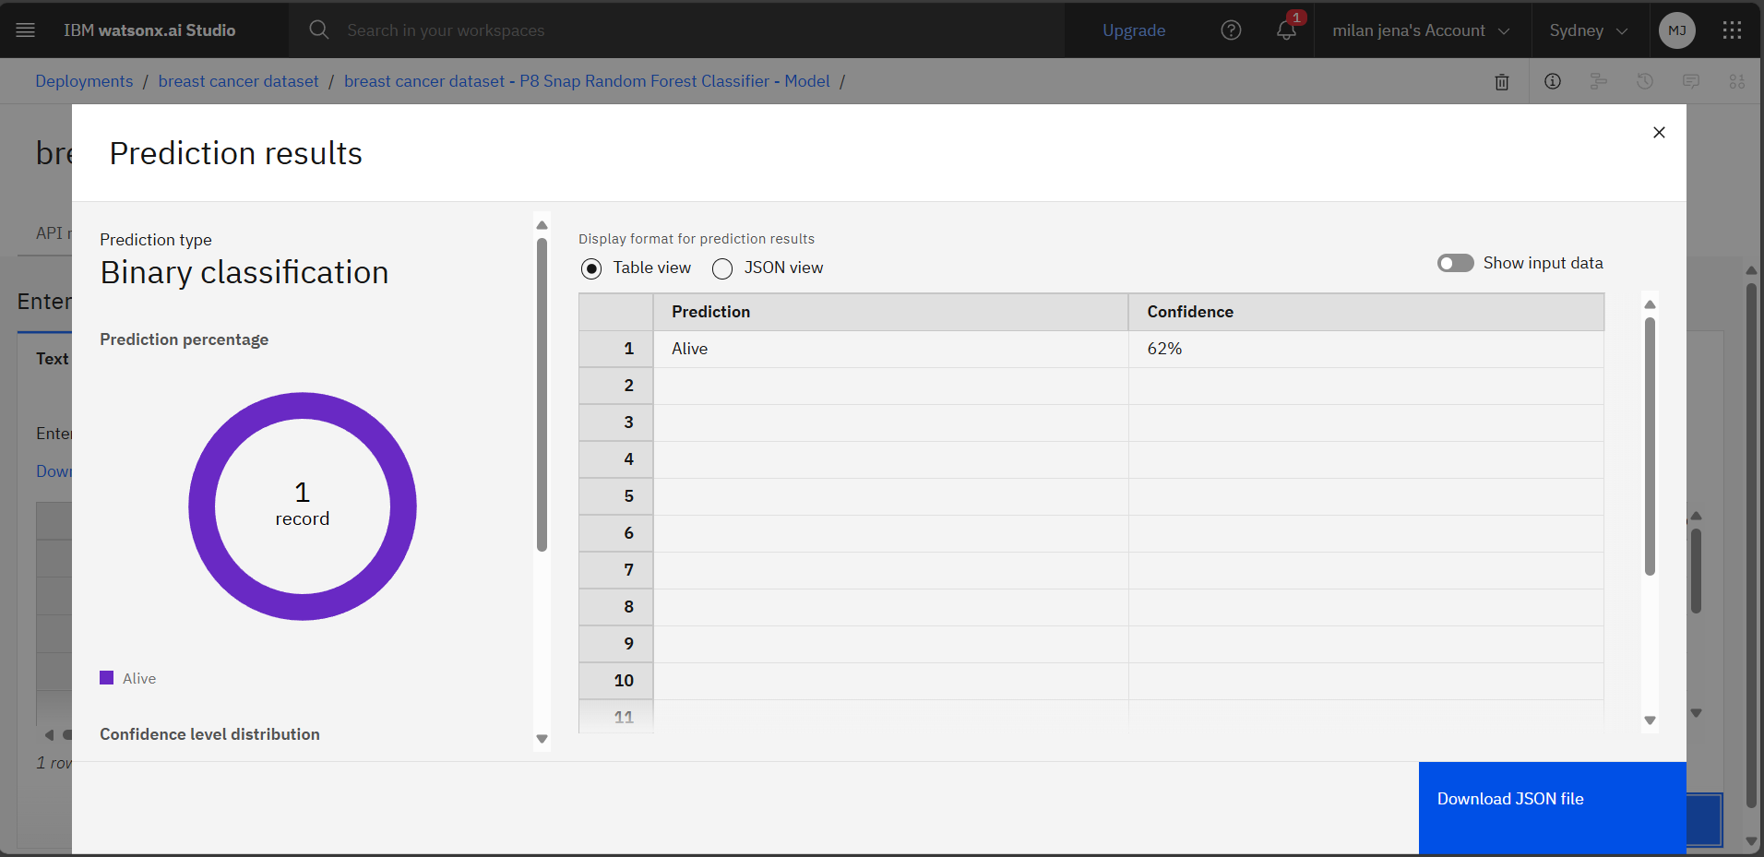
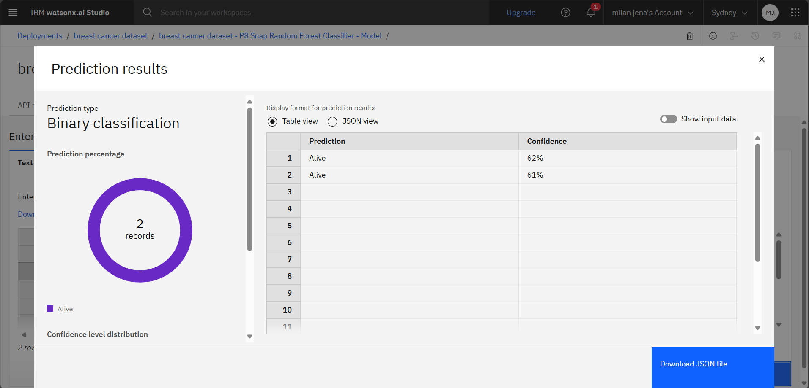
Results

Slide 9
Conclusion
Early and accurate detection of breast cancer is crucial for improving patient outcomes. However, current diagnostic methods have limitations, highlighting the need for more reliable, non-invasive, and accessible solutions. This project aims to leverage artificial intelligence (AI) to enhance diagnostic precision, efficiency, and individualized treatment planning. By integrating AI-driven models into breast cancer detection, we can significantly improve early diagnosis, reduce invasive procedures, and provide personalized care. Ultimately, this innovation has the potential to revolutionize breast cancer management, benefiting patients, healthcare professionals, and the medical community as a whole.

Slide 10
GitHub Link
https://github.com/ashishkumar-arX/Breast_Cancer_Prediction

Slide 11
Future scope
Enhanced AI Accuracy – Continuous improvement of AI models using larger datasets to increase detection precision and reduce false positives/negatives.
Integration with Wearable Technology – Developing AI-powered wearable devices for real-time breast cancer screening and early warning systems.
Personalized Treatment Plans – Advancing AI-driven treatment recommendations based on genetic, lifestyle, and medical history data.
Global Accessibility – Expanding the reach of AI-based diagnostic tools to remote and underdeveloped areas, improving healthcare equity.
Collaboration with Healthcare Systems – Integrating AI models into hospital workflows for faster, more efficient diagnosis and treatment planning.
Multimodal Diagnosis – Combining AI with imaging, blood biomarkers, and genomic data for a more comprehensive breast cancer detection approach.
Regulatory Approvals & Standardization – Working towards obtaining medical certifications and regulatory approvals to ensure widespread clinical adoption.This project has the potential to revolutionize breast cancer detection and treatment, making healthcare more precise, accessible, and patient-centric

Slide 12
IBM Certifications
Screenshot/ credly certificate( getting started with AI)
Student 1 & student 2

Slide 13
THANK YOU

